Slide 1

CYBR8470 Secure Web Applications Development
Fall Semester 2021
Class Project:
Mobile and Web Application for
Amateur Radio Emergency Services
‘AERS’
Bob Wilmes AGØLF
December 16, 2021

Slide 2




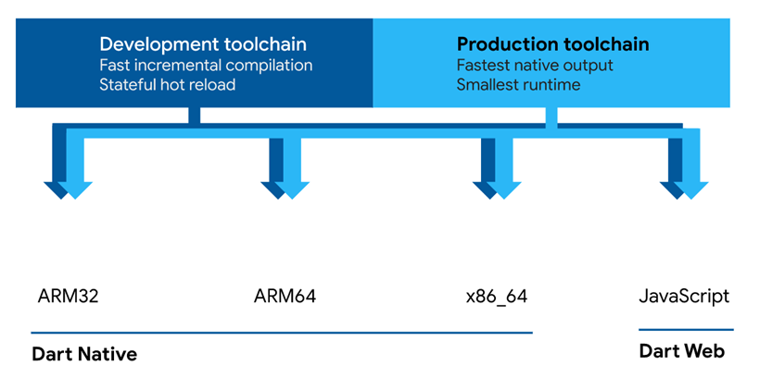
Background of the AERS project
The initial goal of the project is to support data collection by ham radio operators operating as a communications network to recover from natural and man-made disasters. In Omaha, the Amateur Radio Emergency Service (ARES) is affiliated with the Aksarben chapter of the American Red Cross. ARES is organized in the US by the Amateur Radio Relay League, a 501c3 charity which promotes amateur radio use.
The projected targeted a mobile application using the Dart programming language
running under the Flutter framework on iOS, Android and Chrome web browsers.
Dart was developed along with the Flutter framework by Google. It generates native
machine code for ARM32, ARM64, Intel x86_64 CPU’s and cross compiles to
JavaScript and Web Assembler language.

Slide 3
Figure 1 - Aers Architecture Block Diagram
aers
Flutter
iOS App
(Mobile)
Ham Radio
Transceiver
HF
(Mobile)
RF Energy – 2400 symbols/second
Bluetooth 5.0
aers
Flutter
Android App
(Mobile)
Ham Radio
Transceiver
Yaesu System Fusion
RF Energy – 2400 symbols/second
Bluetooth 5.0
aers
Flutter
Browser App
(Laptop)
Ham Radio
Transceiver
Icom/Kenwood
DSTAR
Bluetooth 5.0

Slide 4
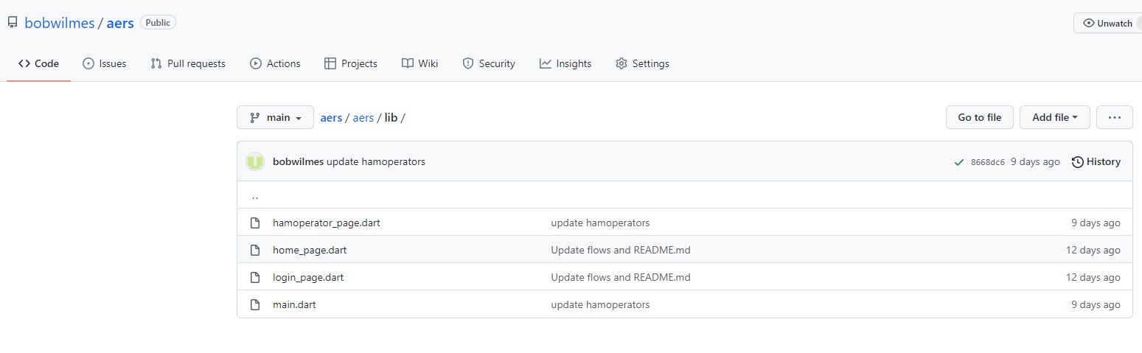
AERS – the incomplete app
As I became deeply involved in the Ham Radio application it became evident that
as I added additional screens the complexity exceeded my skill level in Dart and
Flutter. I spent literally a hundred hours watching flutter development videos.
Incomplete repository: https://github.com/bobwilmes/aers.git

Slide 5
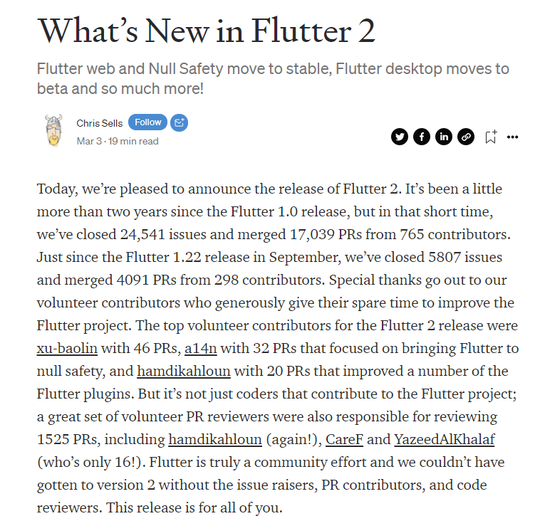
Flutter 2.0 March 2021 breaks the world!
The addition on the null safety to Flutter 2.0 in March 2021 caused an issue for many existing code projects in github.
Flutters’ version of Lint (“$ dart analyze .”) can report on the variances but does not mitigate them.
In addition, Flutter guides and references published
prior to March 2021 do not cover the issues at all.
https://medium.com/flutter/whats-new-in-flutter-2-0-fe8e95ecc65

Slide 6
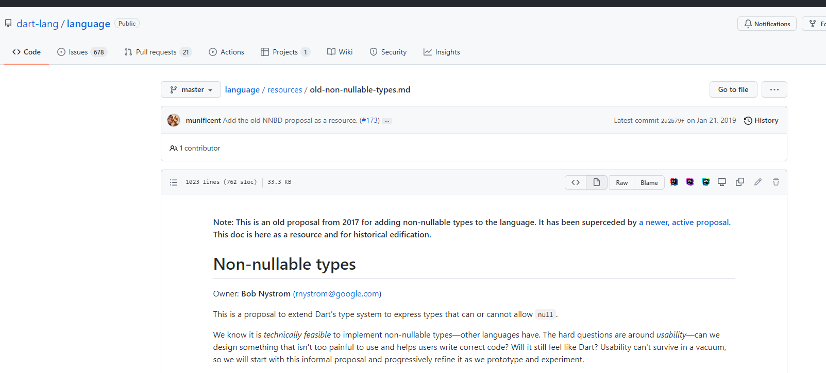
Dart’s non-nullable datatypes
One of the difficulties learning flutter and Dart is the changes still being made to the language.
In 2017, Bob Nystrom from Google started adding features that prohibited references to
functions that previously could have passed or returned values as null. This is explained here
but has broken a lot of code released prior to Flutter 2.2
https://github.com/dart-lang/language/blob/master/resources/old-non-nullable-types.md

Slide 7
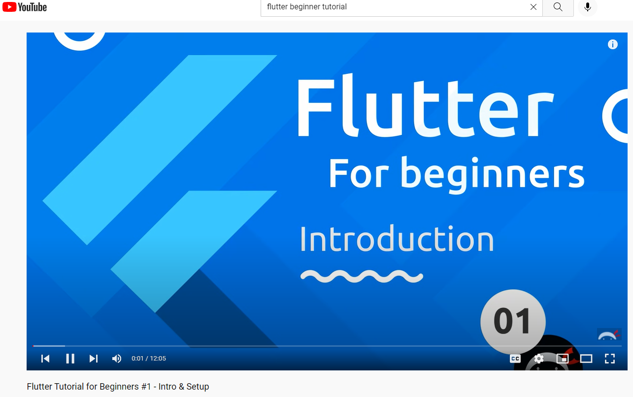
Completing the World Time application
One of the maxims of the software world is working code carries 90% of the weight of a project. I decided to simplify my project. My plans for the ham radio project became much more complex.
As I didn’t understand async code and futures required to communicate externally off the mobile device.
I chose to base my project on the “Flutter-Beginners-Tutorial” github project and YouTube videos.
https://github.com/iamshaunjp/flutter-beginners-tutorial
https://www.youtube.com/watch?v=1ukSR1GRtMU&list=PL4cUxeGkcC9jLYyp2Aoh6hcWuxFDX6PBJ
As I watched the videos, I manually entered the code from the video character by character. This was so
I could utilize Flutter’s instantaneous compilation feature and painfully learn Dart syntax.
The challenge was the videos and code were written for Flutter 1.0
and haven’t been upgraded since 2019.
My project became to modernize the World Time application to
run under non null code under Flutter 2
Completed Flutter 2 World Time repository: https://github.com/bobwilmes/worldtime.git

Slide 8


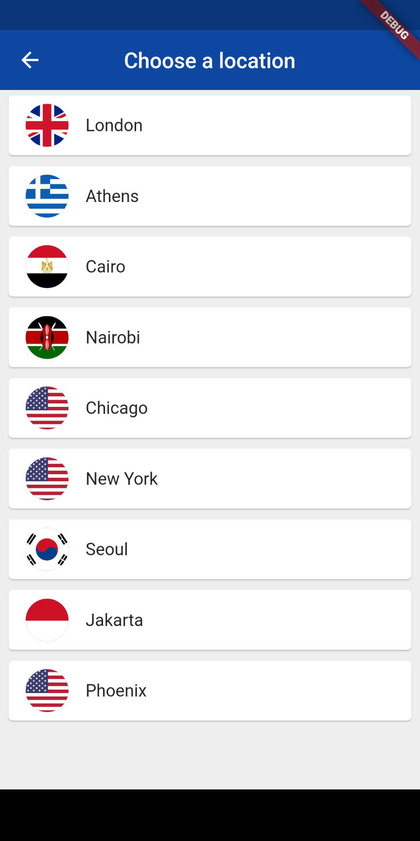


World Time app showing the changes in the background and screens
Note: slightly changed color on upper app screen bar between day and night
Touch Edit Location
Icon to change locations
Touch to return
Daytime
Background
Stretched Background
Time and Location
With Edit Location
Control
Nighttime
Background
Stretched Background
Time and Location
With Edit Location
Control
Choose Location
Screen with
Cities and Flags
Buttons
Touch Flag Icons to select city

Slide 9
What I Learned from World Time for Flutter 2
The World Time application uses several functions which were required of the project.
First, an initial loading page is created while a https call is made to a JSON REST web service
provided by WorldTimeAPI.org
Because flutter code runs asynchronously a rendezvous is made between the https library
call and an a callback using the “future” option. The call returns a list of parameters which
is parsed to JSON and the parameters are placed in memory using a map object.
The home page is placed on the stack and shows the current time and location. Background
shading is applied depending on local time of day.
Second, an edit location button loads a screen on the stack, which allows the user to choose
alternate locations around the world. The icons for the locations are created dynamically at
run time from list. When a icon is clicked, the location screen is popped off the flutter stack
and the parameters are passed back using a map.
Third, I learned how to separate the organization of code in the project into separate subdirectories
depending on the screen in the application. This made the debugging process clear, given the
Flutter stack use to transfer screens.

Slide 10
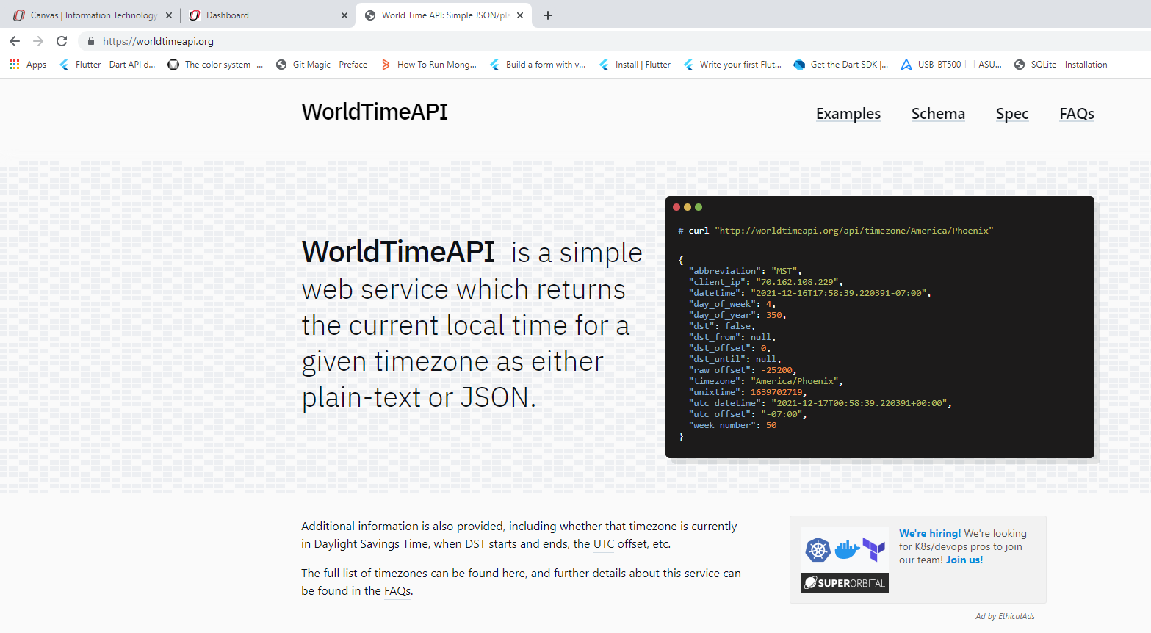
WorldTimeAPI.org
This is the https asynchronous request to obtain the current for a geographic location

Slide 11
Futures for the Project
I used the Android Studio to complete the World Time project, but I plan to return
to the Visual Studio Flutter plug-ins to finish the emergency radio project.
The Flutter plug-in for Bluetooth supports streaming Bluetooth connections but
I need to build a mini-project to determine Bluetooth Low Energy (BLE) support
which doesn’t require device pairing.
Add the SQLite database support for the project. Connect a bridge to the Firestorm
Google supported database for initial data load on the mobile device. This will enable
loading reference data when connectivity to the Internet is not available.
Investigate taking pictures from Flutter and local storage.
Create forms for data entry and validation of user information.
Use the ARES Field Operations manual for additional reference information.
Build a testing/CI framework on Github

Slide 12
References
Flutter for Dummies Amateur Radio Emergency Service®
by Barry Burd, PhD ARES® Field Resource Manual
Copyright 2020 John Wiley & Sons Copyright © 2005-2021
ISBN 978-1119612582 American Radio Relay League, Inc.
ISBN 978-0872595439
Flutter in Action
by Eric Windmill
Copyright 2020 Manning Publications
ISBN 978-1617296147
Flutter Complete Reference
by Alberto Miola
Copyright <none listed>
ISBN 979-8691939952
Completed repository: https://github.com/bobwilmes/worldtime.git
Incomplete repository: https://github.com/bobwilmes/aers.git
World Time API: https://worldtimeapi.org

